Slide 1

SCiP, 2022
Business Meeting

Slide 2

Thanks to Sponsor PST!
Please visit their website for more information https://pstnet.com/.

Slide 3
SCiP Organizers / Openings
Thanks to all the amazing efforts of SCiP President Laura Allen.
Election for 2022 leadership positions is confirmed:
President Elect: Caitlin Mills
Steering Committee: Sheila Kennison and Katie McCarthy

Slide 4
Conference Report
We had 8 posters, 2 symposia, 1 workshop, and 28 presentations scheduled
Way more Castellan full paper submissions.
Shortened the report format
Pushed the date back
Winners announced via email
11 Birnbaum awardees this year. Warm thanks to generosity of Birnbaum Foundation.
Welcome new student SCiP members!

Slide 5
SCiP Budget / Membership
SCiP budget is healthy (about $6,000, approximately 2 conference “buffer”)
Registration based on cost of conference to cut as even as possible.
Donating to Black Girls Code and AllStarCode as part of SCiP’s commitment to expanding opportunity and equality.
Immense thanks to Psychonomic Society for their support (approximately $4500).

Slide 6

FABBS (fabbs.org)
FYI: SCiP is a member society. Advocacy for behavioral and brain sciences in Washington. Visit fabbs.org.

Slide 7
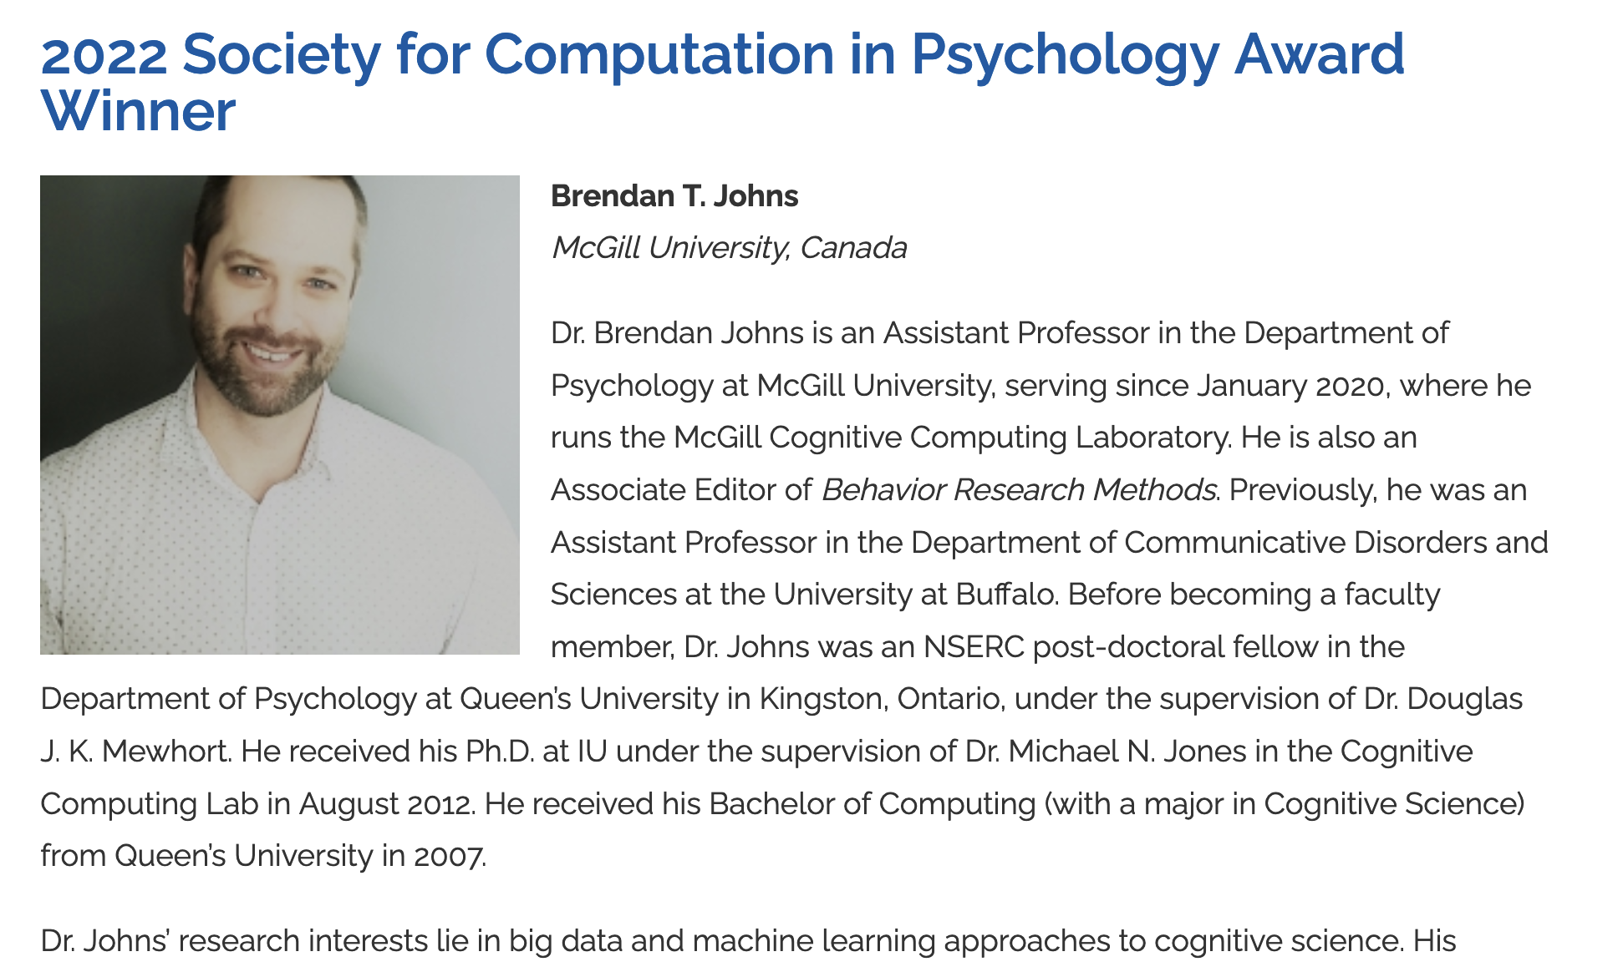
Congrats Brendan!

Slide 8
SCiP 2023
SCiP 2023: San Fransico!
All feedback is warmly welcomed.
Consider joining on as President or Steering Committee member for 2023! Nominate folks when submitting for next year.

